Slide 1
Kernel Principal Component Analysis and Multidimensional Scaling

Slide 2
Learning Goals
In this section, we will cover:
- Linear Transformation overview
- Nonlinear Transformation: Kernel PCA and Multi-Dimensional Scaling (MDS)

Slide 3
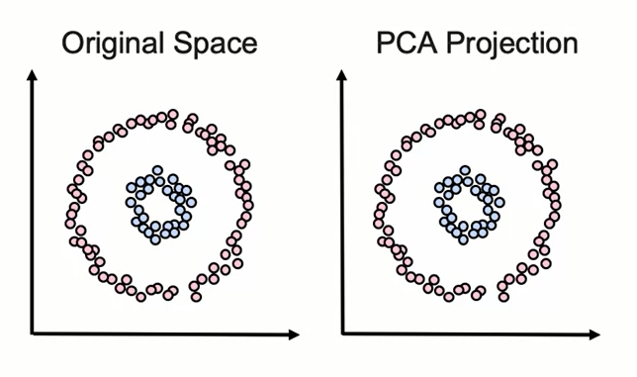
Moving Beyond Linearity
– Transformations calculated with PCA/SVD are linear.

Slide 4
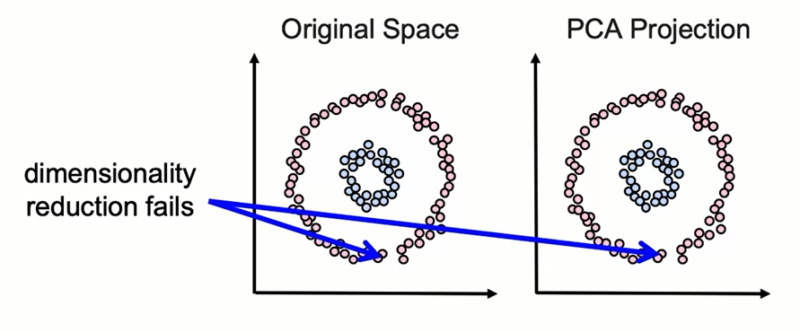
Moving Beyond Linearity
- Transformations calculated with PCA/SVD are linear.
- Data can have non-linear features.
- This can cause dimensionality reduction to fail.

Slide 5
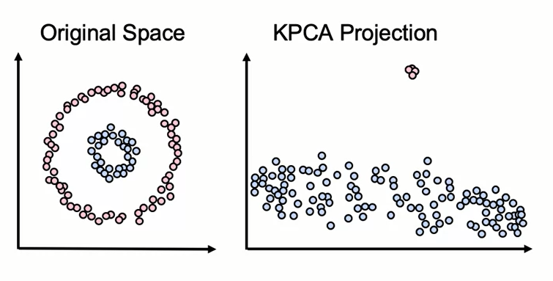
Kernel PCA
- Solution: kernels can be used to perform non-linear PCA.

Slide 6
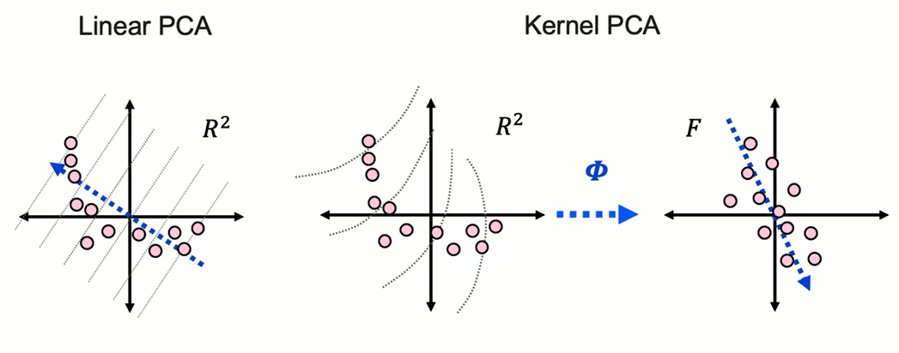
Kernel PCA
- Solution: kernels can be used to perform non-linear PCA.
- For example: the kernel trick introduced for SVMs.

Slide 7
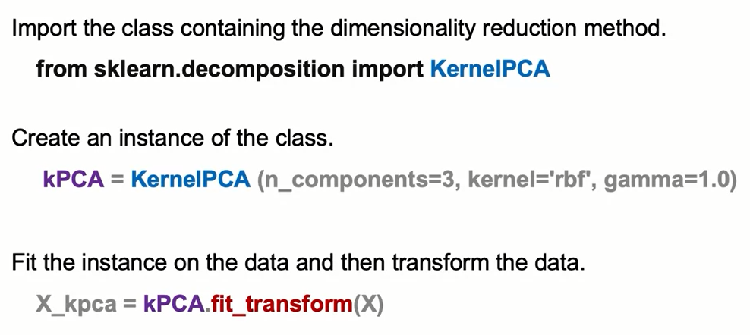
Kernel PCA: The Syntax

Slide 8
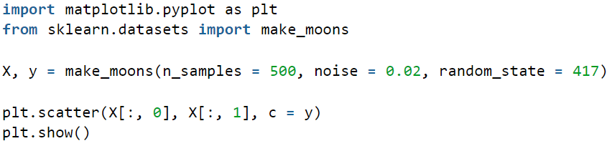
Kernel PCA: The Syntax
Example:
Create a dataset which is nonlinear:

Slide 9
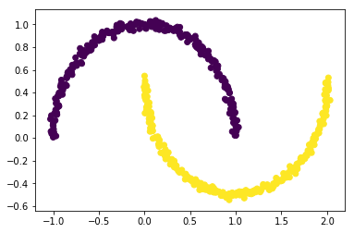
Kernel PCA: The Syntax

Slide 10
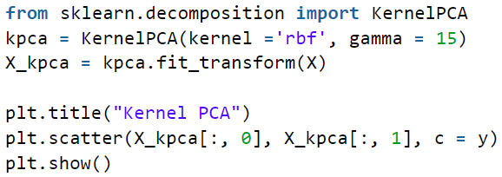
Kernel PCA: The Syntax
Applying kernel PCA on this dataset with RBF kernel with a gamma value of 15.

Slide 11
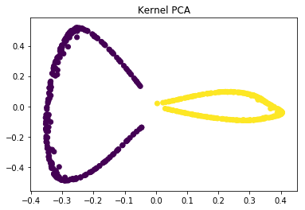
Kernel PCA: The Syntax
In the kernel space the two classes are linearly separable. Kernel PCA uses a kernel function to project the dataset into a higher-dimensional space, where it is linearly separable. Finally, we applied the kernel PCA to a non-linear dataset using scikit-learn.

Slide 12
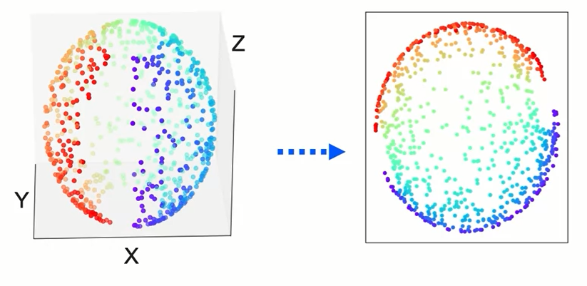
Multi-Dimensional Scaling (MDS)
- Non-linear transformation
- Doesn't focus on maintaining overall variance.
- Instead, maintains geometric distances between points.

Slide 13
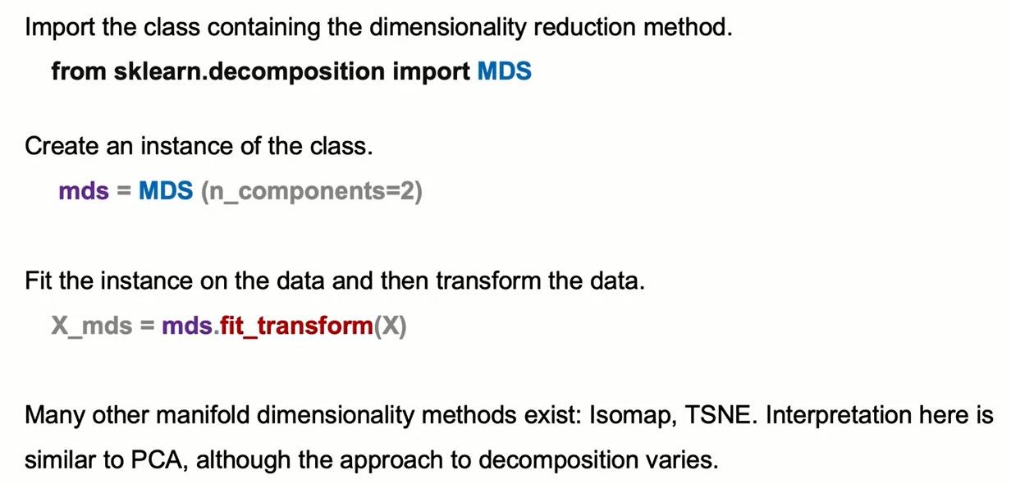
Multi-Dimensional Scaling: The Syntax

Slide 14
Summary
In this module, we learned about two dimensionality reduction techniques.
Kernel principal component analysis (Kernel PCA)
Kernel principal component analysis (PCA) is an extension of principal component analysis (PCA) using techniques of kernel methods. Kernel principal component analysis maps the data to a higher dimension using kernels with their corresponding parameter.
There are different choices of kernels: linear, poly, rbf, sigmoid, cosine
Unlike PCA, Kernel PCA may not give perfect reconstruction
There are many more free parameters: gamma, alpha

Slide 15
Summary
Syntax
An example of a KernelPCA object is given here:
kernel_pca = KernelPCA( kernel="rbf", gamma=10, fit_inverse_transform=True, alpha=0.1)
We can fit the model and make a prediction:
kernel_pca.fit(X_train)
score_kernel_pca = kernel_pca.transform(X_test)

Slide 16
Summary
Multi-Dimensional Scaling
Multi-Dimensional Scaling (MDS) is a family of algorithms, one version of which is Principal Component Analysis (PCA).
Like PCA, MDS can be used for dimensionality reduction; MDS can also be used to map complex differences into visual space. The difference is that MDS preserves the distance between data points. There are many types of distances called dissimilarity metrics.

Slide 17
Summary
Metric MDS
Metric MDS represents points in an embedding. It determines the embeddings by minimizing a distance metric.
Non-Metric MDS
In Non-Metric MDS, we apply a function f(.) to the distance metric before minimizing the distance metric.
We can create the object this way:
embedding = MDS(dissimilarity='precomputed', random_state=0, n_components=2, metric=False)

Slide 18
Learning Recap
In this section, we discussed:
- Linear Transformation overview
- Nonlinear Transformation: Kernel PCA and Multi-Dimensional Scaling (MDS)

